Slide 1

DETECTION OF BRAIN TUMOR USING CNN WITH WAVELET
SUPERVISOR:
Dr. Dillip Ranjan Nayak
MEMBERS:
Anand Kumar Sahoo(2101110028)
Aswojit Samal(2101110036)
Swati Nath(2101110119)
Ananya Rani Panda(2221110002)
Government College Of Engineering Kalahandi, Bhawanipatna
Date- 08/05/2025

Slide 2
CONTENTS
INTRODUCTION
MOTIVATION
RECENT WORK
CHALLENGES
OBJECTIVE
OVERVIEW
METHODOLOGY
WORKFLOW
RESULT ANALYSIS
CONCLUSION
FUTURE SCOPE
REFERENCES

Slide 3
INTRODUCTION
In the field of Medical Image Analysis, research on Brain tumors is one of the most prominent areas.
Primary brain tumors affect in around 250,000 people a year globally, making up less than 2% of cancers.
Tumor segmentation is one of the most difficult task in medical image analysis.
Classification of the tumor as tumorous or non-tumorous is a primary task in this domain.

Slide 4
MOTIVATION
Well adaptation of automated medical image analysis in the perspective of Nation’s medical sector.
Early detection of Brain Tumors Reducing the pressure on Human judgement.
Build a User Interface which can identify the cancerous cells.
Reducing the death rate by early detection.
Supporting faster communication, where patient care can be extended to remote areas.

Slide 5
RECENT WORKS
Agrawal et al. (2024): Introduced a Wavelet-based CNN (wCNN) model utilizing the BRATS 2023 dataset, achieving an accuracy of 96.69%.
Enhanced CNN Approach (2024): Combined Discrete Wavelet Transform (DWT) with an improved CNN architecture, resulting in an accuracy of 98.9%.
Abda & Naimi (2025): Developed a model integrating Stationary Wavelet Transform (SWT), ResNet50V2, and LSTM networks, achieving an accuracy of 98.7%.
Gokapay & Mohanty (2024): Utilized Berkeley Wavelet Transform with a two-channel CNN, reporting an accuracy of 98.8%.
Wavelet Texture Features with Optimized ANN (2024): Employed wavelet-based texture features and Principal Component Analysis (PCA) with an optimized Artificial Neural Network (ANN), attaining an accuracy of 98.78%.
Modified VGG16 Architecture (2024):Enhanced VGG16 with additional dense layers and dropout for improved classification of MRI brain tumors reporting an accuracy of 99.08%.

Slide 6
CHALLENGES
1. MRI Image Variability
Different scanner types, resolutions, and protocols affect image consistency.
Hard to generalize across datasets without preprocessing.
2. Wavelet Feature Complexity
Choosing optimal wavelet type and decomposition level is non-trivial.
High dimensionality from wavelet coefficients can lead to overfitting.
Trade-off between preserving fine details and reducing noise.
3. CNN Overfitting Risk
Small datasets may cause CNNs to memorize patterns rather than generalize.
Requires augmentation and regularization techniques (e.g., dropout, batch normalization).
Need for proper validation to prevent overfitting.
4. Computational Load
Wavelet transformation combined with deep CNNs increases memory and GPU demand.
Slower training times due to large number of parameters.
5. Lack of Annotated Data
Annotated medical datasets are limited and expensive to obtain.
Class imbalance in the dataset (e.g., fewer cases of rare tumors) can affect performance.

Slide 7
OBJECTIVE:-
The primary objective of using machine learning (ML) for brain tumor detection is to develop automated and accurate methods for identifying and classifying brain tumors from medical images like MRI scans, aiding in early and precise diagnosis and treatment planning.
To test & classify the tumors we use different machine learning algorithms like convolutional neural network (CNN),VGG-16,Support Vector Machine(SVM) & Logistic Regression.

Slide 8
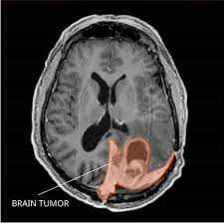
OVERVIEW OF BRAIN TUMOR:-
Brain tumors are abnormal growths of cells in the brain. They can be benign (non-cancerous) or malignant (cancerous), and they can originate in the brain itself or spread from other parts of the body. The presence of a tumor in the brain can interfere with normal brain functions, leading to various neurological symptoms.
IMPORTANCE OF EARLY DETECTION:-
Early detection of brain tumors is crucial for effective treatment and improved patient outcomes. Timely identification allows for prompt medical intervention, reducing the risk of complications and enhancing the chances of successful treatment.

Slide 9
INTRODUCTION TO MACHINE LEARNING ALGORITHMS
To test & classify the tumors we use different machine learning algorithms like Logistic Regression ,Support Vector Machine (SVM) ,CNN & VGG-16 algorithms.
1. Introduction:
SVM (Support Vector Machines) is a powerful supervised learning algorithm primarily designed for classification tasks. However, it can also be adapted for regression and outlier detection tasks.
Its primary strength lies in its ability to handle high-dimensional data and find optimal hyperplanes for classification.

Slide 10
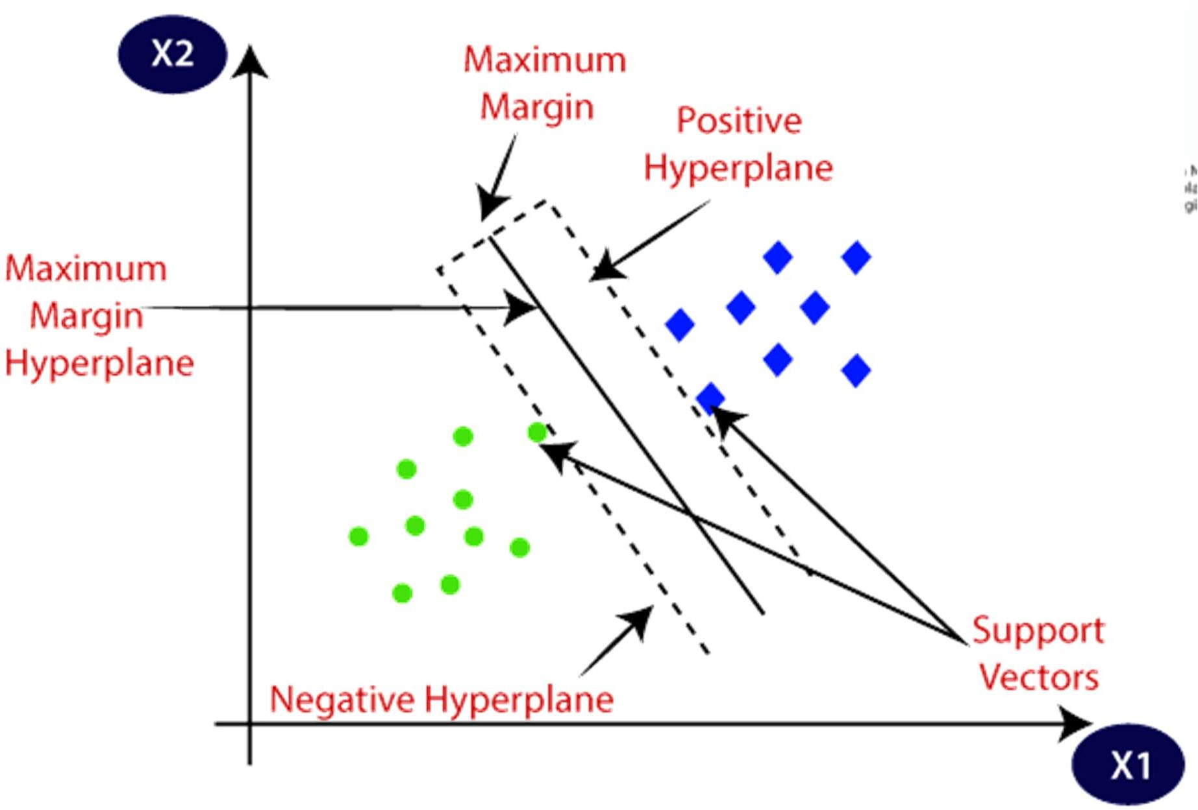
SVM
2. Working Principle:
Hyperplane: In a binary classification scenario, SVM aims to find a hyperplane that best separates the data points into two distinct classes.
Margin Maximization: The algorithm seeks to maximize the margin (distance) between the closest data points (support vectors) of the two classes, ensuring robust generalization.

Slide 11
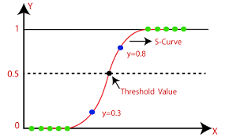
Logistic Regression
1. Introduction:
Logistic Regression is a statistical method used for binary classification problems, predicting the probability of an instance belonging to a particular class.
Despite its name, Logistic Regression is a classification algorithm rather than a regression technique.
2. Working Principle:
Sigmoid Function: Logistic Regression uses the sigmoid (logistic) function to map any input into a value between 0 and 1, representing the probability of the input belonging to the positive class.
Log-Odds: The algorithm models the log-odds of the probability as a linear combination of the predictor variables.
LOGISTIC REGRESSION

Slide 12
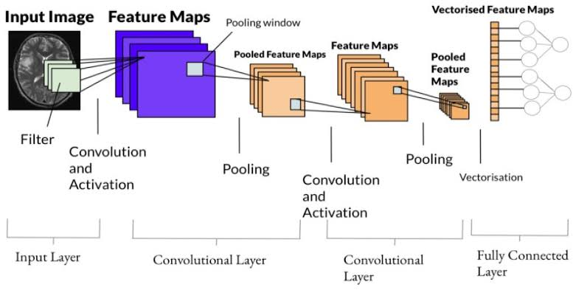
CNN ARCHITECTURE:-
Convolutional Neural Networks (CNNs) are a specialized class of neural networks designed to process grid-like data, such as images. They are particularly well-suited for image recognition and processing tasks.
CNN MODEL

Slide 13
Input Layer: Receives an image (e.g., 224x224 pixels, RGB or grayscale).
Convolution Operation: Slides a filter (kernel) over the image to detect patterns like edges or textures.
Feature Map: Result of convolution; shows where patterns occur.
Multiple Filters: CNN uses several filters to detect different features.
ReLU (Rectified Linear Unit): Removes negative values to keep only meaningful features.
Pooling Layer: Reduces the size of the feature map while keeping essential info (e.g., max pooling takes the largest value).
Dropout (optional): Randomly removes some neurons during training to avoid overfitting.
Flatten Layer: Converts the pooled feature map into a single long vector.
Fully Connected Layers (Dense Layers): Use all features to make predictions.
Softmax/Sigmoid Activation: Converts final output to probabilities (e.g., tumor probability).
Backpropagation: Adjusts filters and weights using loss value to improve accuracy.

Slide 14
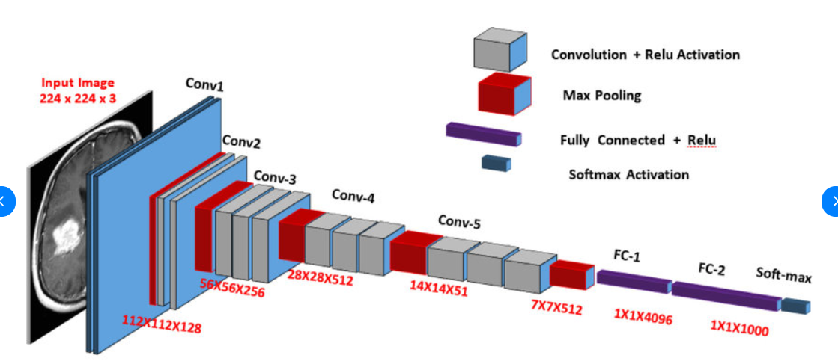
VGG-16 ARCHITECTURE
The VGG-16 model is a convolutional neural network (CNN) architecture
consisting of 16 layers, including 13 convolutional layers and 3 fully connected layers. VGG-16 is renowned for its simplicity and effectiveness, as well as its ability to achieve strong performance on various computer vision tasks, including image classification and object recognition.
Convolution layer
{ filter size=3*3
Stride =1
Padding=same}
MaxPooling layer
{ filter size=2*2
Stride =2 }
Formula
Output Size=[sn+2p−f​]+1
VGG-16 MODEL

Slide 15
WORKING OF VGG-16
Input Layer
Takes an image of size 224×224×3 (RGB image).
Convolutional Layers
Uses 3×3 filters to scan the image.
Detects low-level (edges, textures) and high-level features (shapes, objects).
Total of 13 convolution layers.
ReLU Activation
Adds non-linearity.
Replaces negative values with zero.
Max Pooling Layers
Reduces image size (2×2 filter, stride 2).
Keeps important information, makes the model faster.
5 pooling layers in total.
Flatten Layer
Converts 2D data to 1D for input to fully connected layers.
Fully Connected Layers (Dense Layers)
layers with 4096 neurons each.
Learns to combine features for final decision.
Output Layer (Softmax)
Final layer with 1000 neurons (or fewer for specific tasks).
Gives probability for each class.

Slide 16
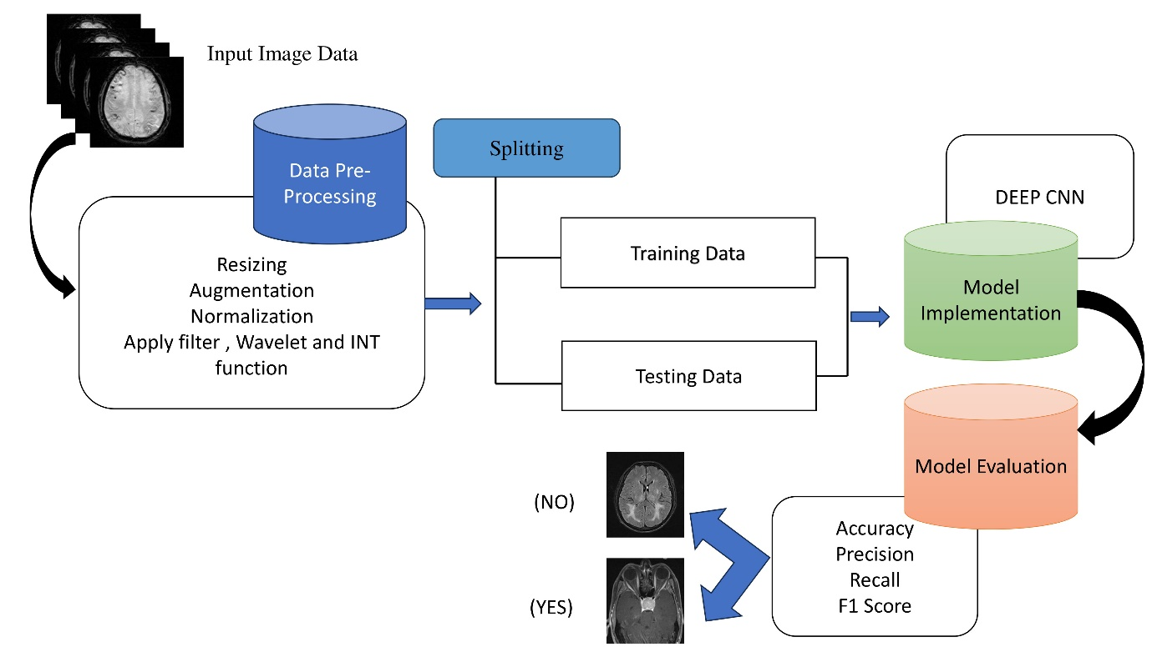
WORKFLOW
The proposed system for brain tumor classification using deep learning and image processing techniques follows a structured workflow divided into several key stages. Each stage contributes critically to the overall performance and accuracy of the model. The following outlines the step-by-step process illustrated in the workflow diagram:-

Slide 17
DATASET
Total Dataset | Total class | Split | Training Dataset Without augmentation | Training Data set after augmentation | Testing Dataset
1222 | 2 | 8:2 | 977 | 4523 | 249
Datasets For Detection:
1. National Cancer Institute (.gov)
2.National Institute of Health (NIH)(.GOV)
3.The Cancer Imaging Archive

Slide 18
DATA PREPROCESSING
RESIZING
All MRI images were resized to a fixed dimension of 224×224×3 pixels , Ensures uniform input size for the Model Implementation.
Augmentation
Rotation of images within a 20-degree range.
Horizontal flipping of images.
Width and height shifting by 20%.
Shear transformation up to 20%.
Zooming in and out by 20%.

Slide 19
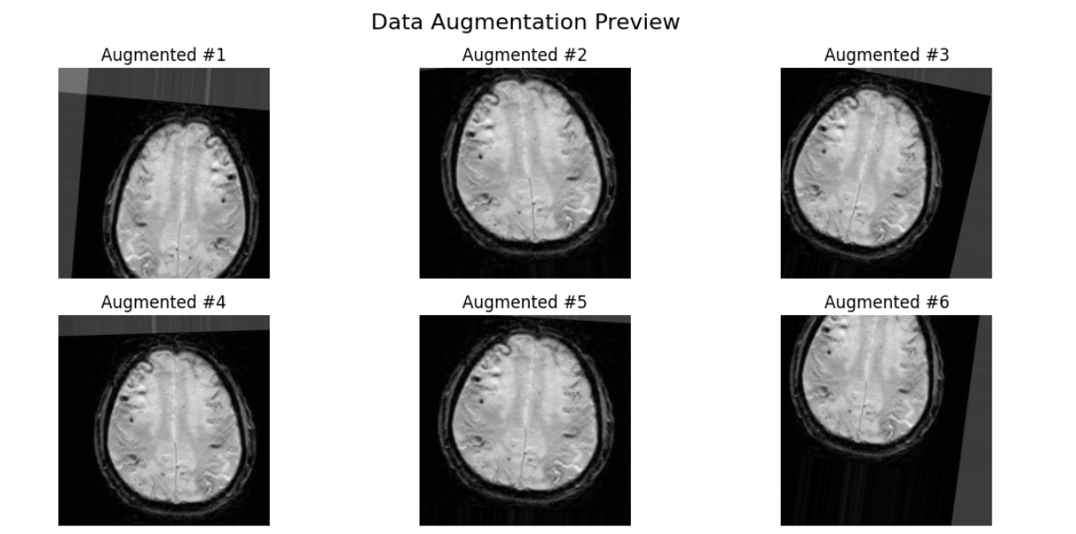
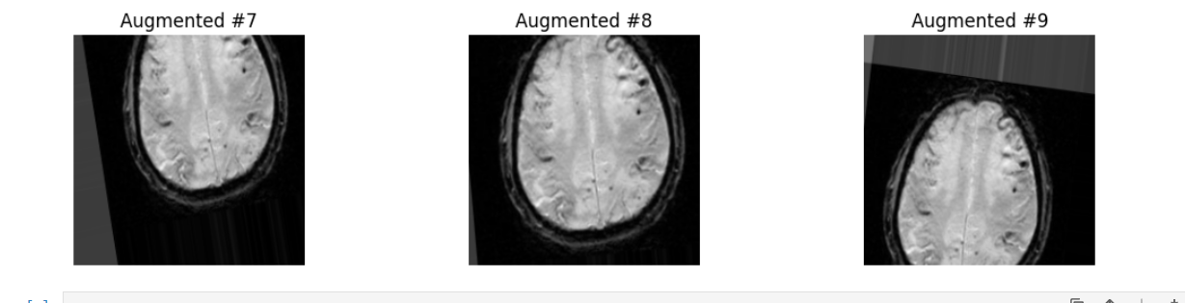
AFTER AUGMENTATION DATA

Slide 20
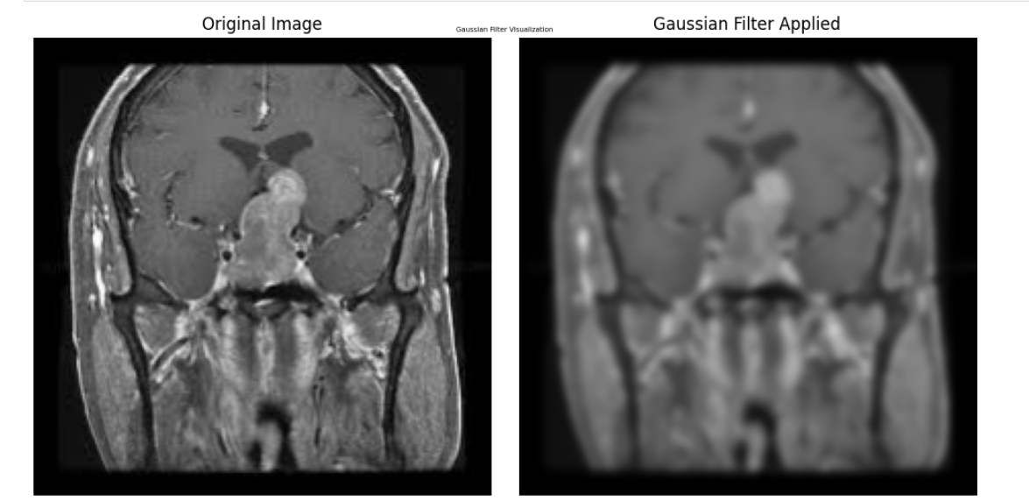
NORMALIZATION
This function scales pixel intensity values from the original [0, 255] range to a format compatible with the pretrained VGG-16 model. The normalization Centred the RGB channels based on ImageNet training statistics.
FILTERS
Filtering was used to improve the visual quality of MRI images by enhancing features or reducing noise. Hear we use Gaussian blur Filter.

Slide 21
APPLYING WAVELET
The wavelet transformation, filters are essential components used to decompose and reconstruct signals or images. In the context of brain tumor detection using CNNs, wavelet filters help in breaking down an image into different frequency components, making it easier to detect subtle features like edges and textures associated with tumors.
Work Of DWT (Discrete Wavelet Transform)
For 2D images (e.g., MRI scans):
The image is passed through horizontal low-pass and high-pass filters
The output is then passed through vertical low-pass and high-pass filters.
This results in four sub-band images:
LL (approximation):Low frequency –retains the basic structure of the image.
LH (horizontal detail):High frequency changes in vertical direction.
HL (vertical detail): High frequency changes in Horizontal direction.
HH (diagonal detail): High frequency noise,edges,textures.
These are often used as inputs to a CNN for better feature representation.

Slide 22
INT FUNCTION
“INT" stands for Integrated Features.
It refers to combining or integrating features extracted from:
The VGG-16 model (deep spatial features)
The Wavelet Transform (frequency or texture features)
So, the INT function or INT method is likely a custom-defined step in the pipeline that merges these features into a single feature vector before classification.
Step-by-step Integration (likely flow in our project):
Input Image → Preprocessing
Apply DWT (e.g., Haar Wavelet) → Get LL, LH, HL, HH features.
Extract CNN Features from VGG-16 (flattened vector from FC layers or last convolutional block).
Concatenate or Fuse Features → This is where the INT function applies.
Combined Feature Vector = [CNN features] + [Wavelet features]This merged vector is richer in information.
Pass to Classifier (Softmax,) Predict tumor/No Tumor.

Slide 23
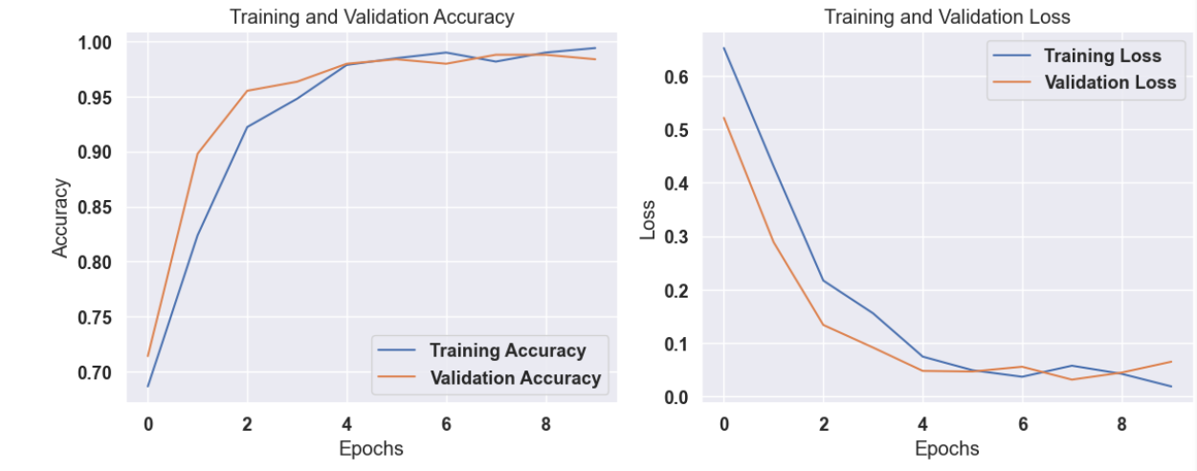
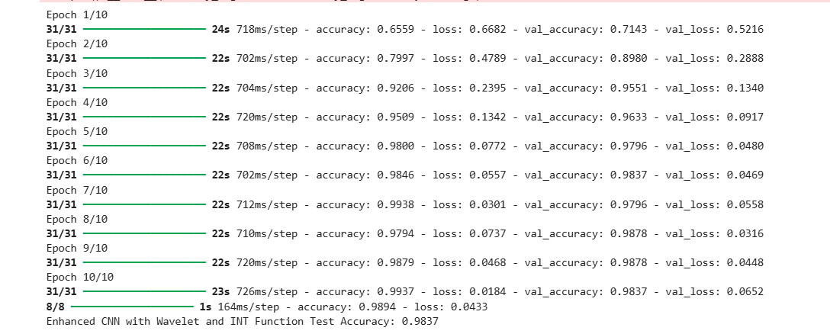
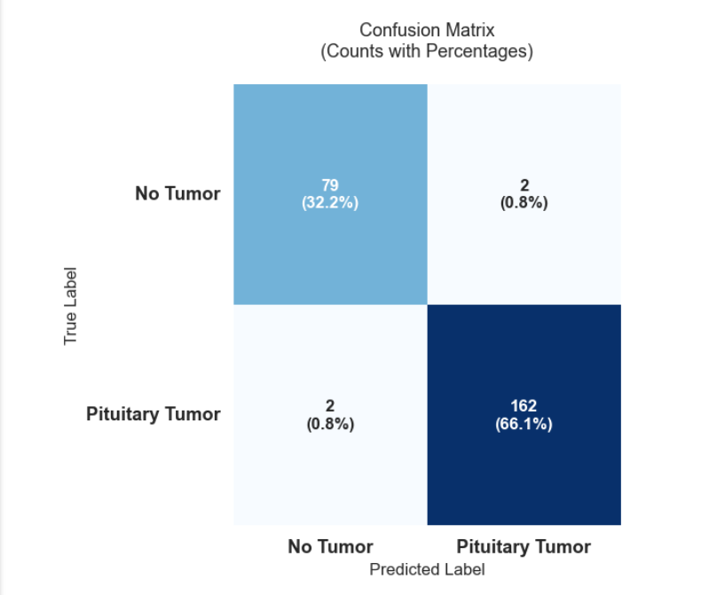
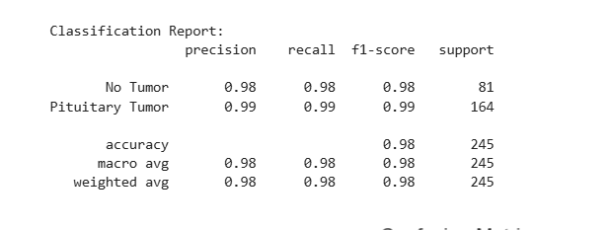
RESULT
CNN:-
=81
=164
TN
FP
=81
=164
FN
TP

Slide 24
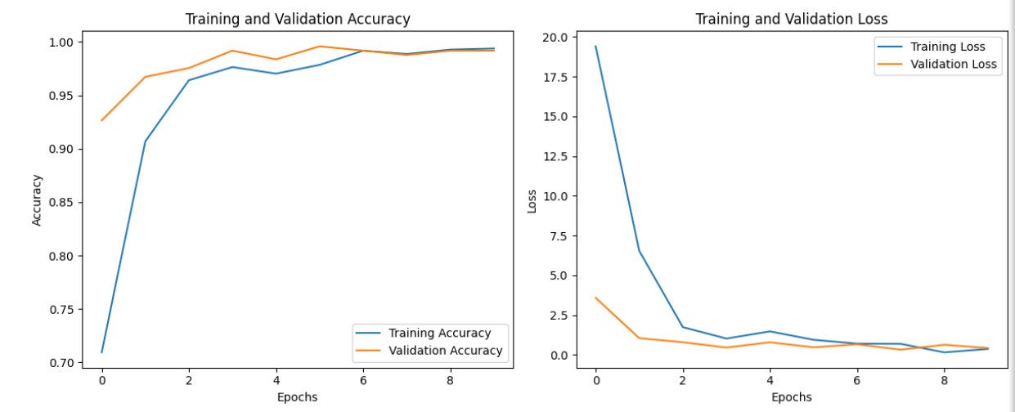
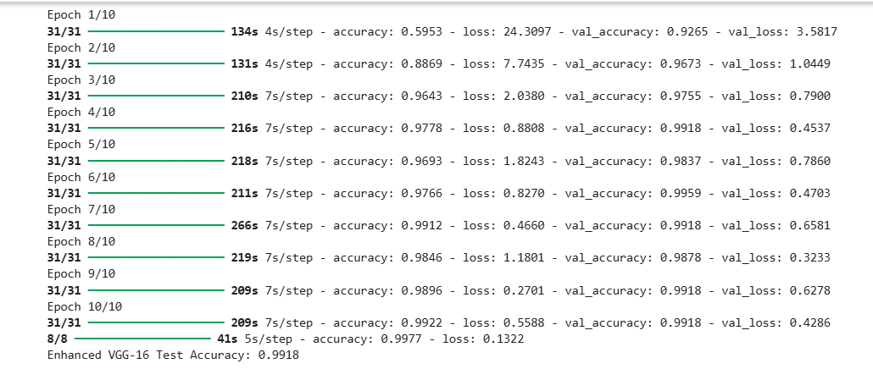
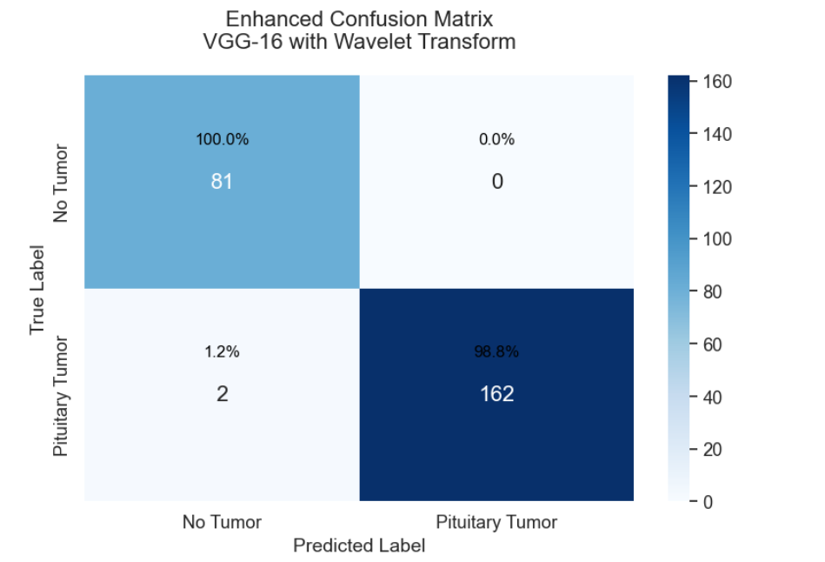
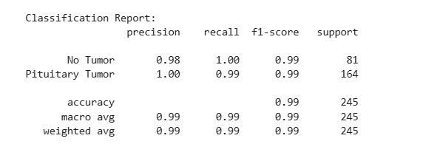
VGG 16:-

Slide 25
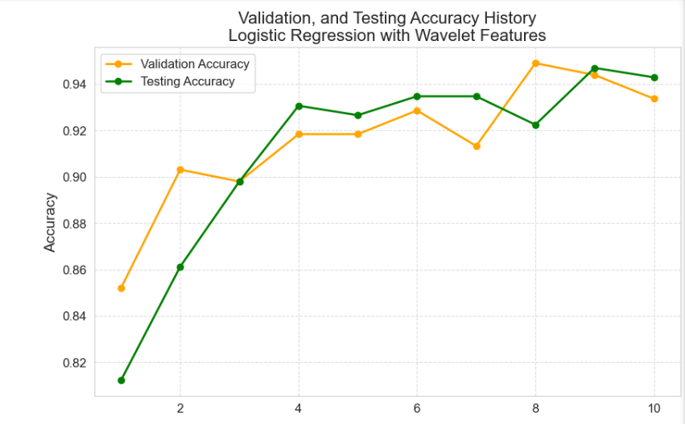
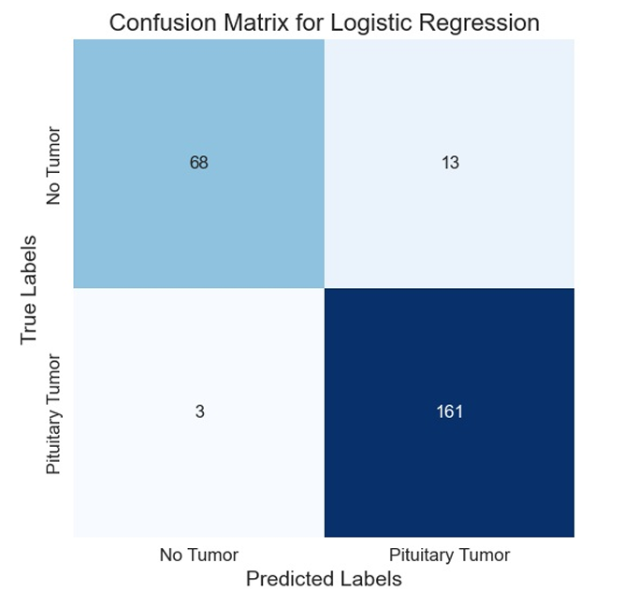
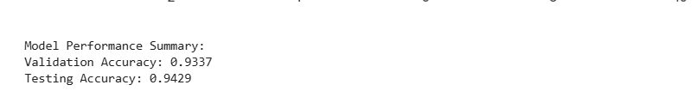
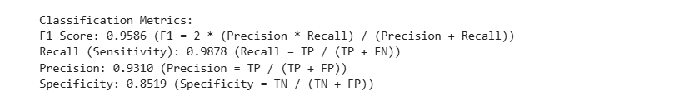
Logistic Regression:-

Slide 26
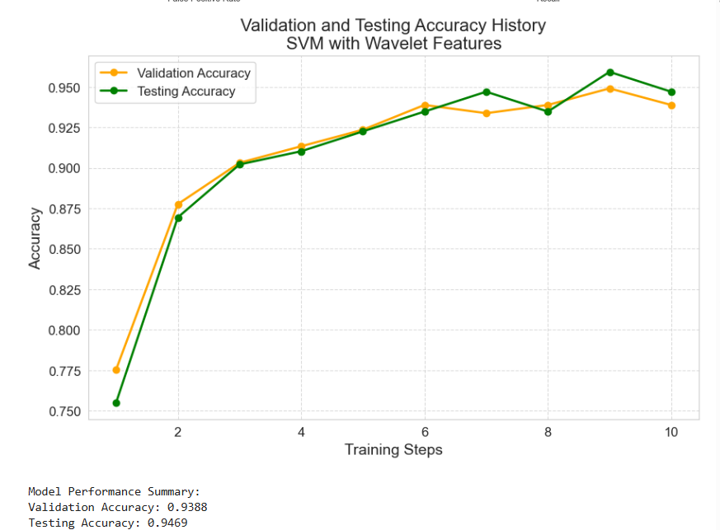
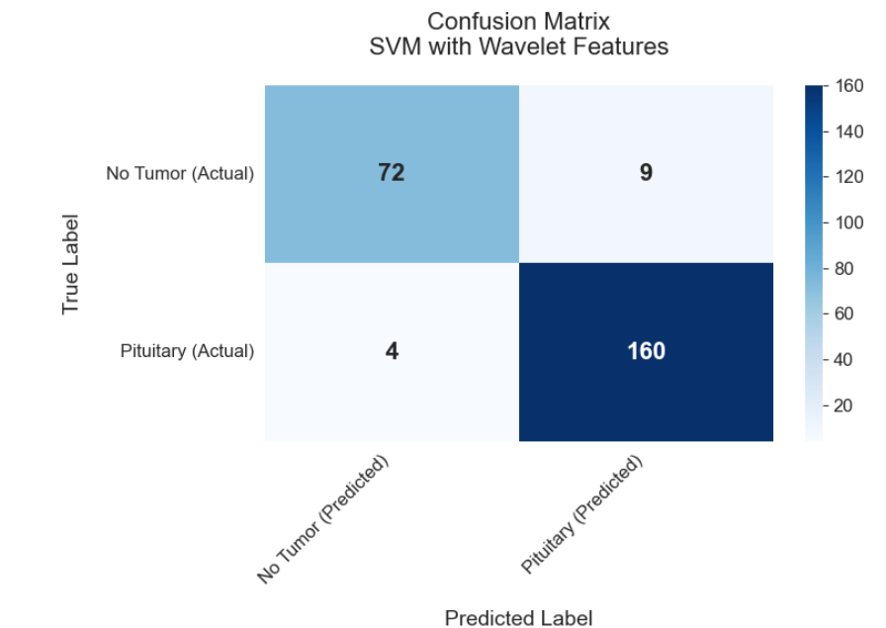
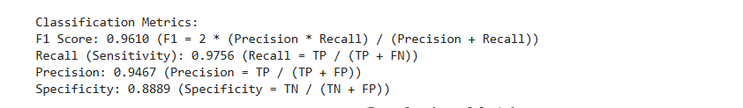
SVM:-

Slide 27
COMPARISON TABLE FOR ALL THE MODEL:-
ALL MODEL WITHOUT WAVELETS
ALL MODEL | ACCURACY | F1 SCORE | RECALL | PRECISION
LOGISTICS REGRESSION | 0.9061 | 0.9322 | 0.9034 | 0.9029
SOPPORT VECTOR MACHINE | 0.9429 | 0.9578 | 0.9695 | 0.9464
CONVOLUTION NEURAL NETWORK | 0.9484 | 0.9419 | 0.9817 | 0.9045
VGG-16 | 0.9551 | 0.95 | 0.96 | 0.96

Slide 28
ALL MODEL WITH WAVELETS
ALL MODEL | ACCURACY | F1 SCORE | RECALL | PRECISION
LOGISTICS REGRESSION | 0.9424 | 0.9586 | 0.9878 | 0.9310
SOPPORT VECTOR MACHINE | 0.9469 | 0.9610 | 0.9756 | 0.6794
CONVOLUTION NEURAL NETWORK | 0.9673 | 0.9750 | 0.9512 | 1.00
VGG-16 | 0.9714 | 0.97 | 0.97 | 0.98
MODEL WITH WAVELET AND INT
ALL MODEL | ACCURACY | F1 SCORE | RECALL | PRECISION
CONVOLUTION NEURAL NETWORK | 0.9837 | 0.9878 | 0.9878 | 0.9878
VGG-16 | 0.9918 | 0,99 | 0.99 | 1.00

Slide 29
EXISTING MODELS FOR COMPARISON
AUTHORS | YEAR | MODEL | ACCURACY | PRECISION | RECALL | F1-SCORE
Badza et al. | 2020 | CNN | 96.56% | 94.81% | 94.81% | 94.94%
Hashemzehi et al. | 2020 | CNN and NAND | 96.00% | 94.49% | 94.49% | 94.56%
Díaz-Pernas et al. | 2021 | Multi-scale CNN | 97.00% | 95.80% | 95.80% | 96.07%
Sajja et al | 2021 | Deep-CNN | 97.00% | 97.05% | 97.05% | 97.05%
D. R Nayak , N.M Padhy , P.K Mallick , Mikhail Zymbler and Sachin Kumar | 2022 | Dense Efficient-Net | 98.78% | 98.75% | 98.75% | 98.75%
Baiju Babu Vimala et al | 2023 | EfficientNet-B2 | 99.06% | 98.73% | 99.13% | 98.79%
Francisco Javier Dfaz-Pernas et al | 2024 | Multiscale-CNN | 97.30% | - | - | -
Proposed Model | Present | Enhanced VGG-16 with wavelet and INT function | 99.18% | 99.00% | 99.00% | 99.00%

Slide 30
CONCLUSION
Brain tumor detection using CNN With Wavelet has become a promising area of research in medical image analysis . Recent studies have demonstrated the effectiveness of deep learning-based approaches in accurately detecting and segmenting brain tumors, as well as predicting patient survival. Various CNN architectures have been utilized along with transfer learning techniques to improve model performance. However, there are still challenges and limitations that need to be addressed, such as the lack of annotated data and interpretability of deep learning models. Therefore, further research is needed to develop more robust and accurate models that can be used in clinical practice.

Slide 31
FUTURE GOALS:-
We will work on reducing Overfitting.
Keep improving accuracy with new data and feedback.
Expand from 2D MRI slices to 3D volumetric analysis for better understanding of tumor growth and location.
Develop a lightweight version for deployment on mobile or web platforms for broader accessibility.

Slide 32
REFERENCES
[1] H. Mohsen, E.-S. A. El-Dahshan, E.-S. M. El-Horbaty and A.-B. M. Salem, “Classification using deep learning neural networks for brain tumors,” Future Computing and Informatics Journal, pp. 68-71, 2018.
[2] S. Bauer, C. May, D. Dionysiou, G. Stamatakos, P. Buchler and M. Reyes, “Multiscale modeling for Image Analysis of Brain Tumor Studies,” IEEE Transactions on Biomedical Engineering, vol. 59, no. 1, pp. 25-29, 2012.
[3] Islam, S. M. Reza and K. M. Iftekharuddin, “Multifractal texture estimation for detection and segmentation of brain tumors,” IEEE Transactions on Biomedical Engineering, pp. 3204-3215, 2013.
[4] M. Huang, W. Yang, Y. Wu, J. Jiang, W. Chen and Q. Feng, “Brain tumor segmentation based on local independent projection-based classification,” IEEE Transactions on Biomedical Engineering, pp. 2633-2645, 2014.
[5] Hamamci, N. Kucuk, K. Karaman, K. Engin and G. Unal, “Tumor-cut: Segmentation of brain tumors on contrast enhanced MR images for radiosurgery applications,” IEEE Transactions on Medical Imaging, pp. 790-804, 2012.
[6] H. B. Menze, A. Jakab, S. Bauer, K. Farahani and K. Justin, “The Multimodal Brain Tumor Image Segmentation Benchmark,” IEEE Transactions on Medical Imaging, pp. 1993-2024, 2014. Manav Sharma, Pramanshu Sharma, Ritik Mittal, Kamakshi Gupta Journal of Electronics and Informatics, December 2021, Volume 3, Issue 4 307

Slide 33
THANK YOU

